Slide 1
JIT121 Programming Principles
Lecture 3
FOR loop, Arrays, Lists

Slide 2
Goals of Lecture
for loop
Arrays
List<T>
2-D+ Arrays
Array of Arrays

Slide 3
Simplest C# collection type: array
Referencing a collection of data (of the same type) by a single variable name
Python: list (sequence type)
  Values (elements) not necessarily of the same type
  No fixed length
  Various methods: len, max, sort, range …
  0 indexed
C# also has a list type … more later
(Doyle, 2014)

Slide 4
Simplest C# collection type: array
Like Python list, the C# array:
0-indexed elements
various methods/properties built-in
Unlike Python list, the C# array:
stores values of only the same type
fixed length
(Doyle, 2014)

Slide 5
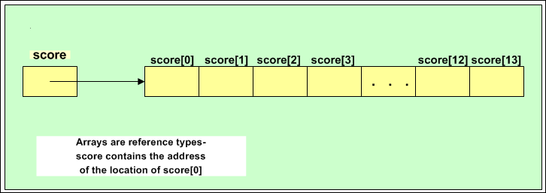
Simplest C# collection type: array
To use an array, you must declare it first
    int[] score = new int[14];
  This creates an array big enough to store 14 integers
  "score is an array of integers of size 14"
int[] score = new int[14];
Arrays are reference types.
score contains the address of the location of score[0]
(Doyle, 2014)

Slide 6
Declaring an Array
General format (syntax):
type[] arrayName = new type[arrayLength];
The type can be any predefined type, like int or string, or any class in C#
    string[] names = new string[4];
The array length must be a whole number
        int numberOfNames = 4;
        string[] names = new string[numberOfNames];

Slide 7
Array Length
Array items are 0-indexed e.g. 0, 1, 2 … (like Python)
Every array has a property Length. A property is like a method, (but no "()" used) and provides access to private fields (more later...)
Length gives the size of the array
      int[] score = new int[14];
      Console.WriteLine(score.Length); // 14
The Length property is read only
  The highest (last) index is always the array length minus one
  Trying to access a higher element (e.g. score[14]) produces a run-time error

Slide 8
Array Initialisation (giving values to)
The general form of initialisation of an array is:
  type[] arrayName = new type[] {value1, value2, … valueN};
    "new type[]" part can be omitted:
  Examples:
  int[] anArray = {100, 200, 400, 600};
  char[] grade = new char[] { 'A', 'B', 'C', 'D', 'F'};
  double[] depth = new double[2] {2.5, 3};
  string[] names = {"Marge", "Lisa", "Homer", "Bart"};
If providing an array length, it must be a whole number inside the square brackets
  no length value is required if initialising with values

Slide 9
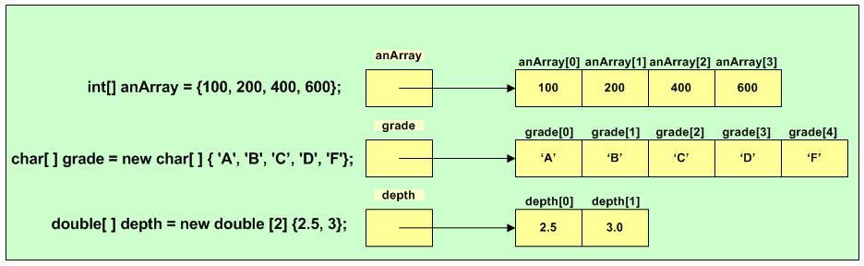
Initialising an array at compile time
(Doyle, 2014)

Slide 10
Storing an array of string
string[] names = {"Marge", "Lisa", "Homer", "Bart"};
names
Length
M
a
r
g
e
4
L
i
s
a
H
o
m
e
r
B
a
r
t

Slide 11
Array Names
On previous slides, some arrays are named singularly – e.g. anArray, grade and depth whereas others are named in plural – e.g. names
Does it matter?
  Opinions differ, but most people prefer plural names because an array is a collection of values (Unfortunately, Doyle often uses singular names)
The JIT121 C# Coding Style Guide stipulates:
  "If array names don’t use the word 'array' in them, then they should be plural." e.g.
  numbers or numberArray
  grades or gradeArray or arrayOfGrades

Slide 12
Array Processing
To display all 14 values in scores array:
    int myIndex;
    …
    myIndex = 0;
    do{
      Console.WriteLine(scores[myIndex]);
      myIndex++;
    } while (myIndex < scores.Length);
Only a few lines of code, but it produces14 lines of output
If the program had to display 1000 scores, we would only need the same few lines of code
Why <
and not <= ??

Slide 13
for: Pre-tested, count-controlled repetition
As a while loop:
initialise
while(test){
action
update
}
As a for loop:
for(initialise; test; update){
action
}

Slide 14
for Loop
      for(initialise; test; update){
      action // loop body
      } // end for
initialise is executed only once
test (a condition) is then evaluated
  If true, then the action (loop body) is executed and update executed. Then test is evaluated again… (potentially repeat this bullet point)
  If false, control passes to next statement after the for block

Slide 15
for Loop: example
// what does this code achieve?
for (int index = 0; index < scores.Length; index++) {
  Console.WriteLine(scores[index]);
  }

Slide 16
Using a for Loop to Count
Add integers from 1 to 10
Output
1: 1
2: 3
3: 6
4: 10
5: 15
6: 21
7: 28
8: 36
9: 45
10: 55
Goodbye
public static void Run(){
int sum = 0;
for (int index = 1; index <= 10; index++ ) {
sum = sum + index;
Console.WriteLine(index + ":\t" + sum);
}
Console.WriteLine("Goodbye");
}

Slide 17
Using a for Loop to Count Backwards
Add integers from 10 to 1
Output
10: 10
9: 19
8: 27
7: 34
6: 40
5: 45
4: 49
3: 52
2: 54
1: 55
Goodbye
public static void Run(){
int sum = 0;
for (int index = 10; index >= 1; index-- ) {
sum = sum + index;
Console.WriteLine(index + ":\t" + sum);
}
Console.WriteLine("Goodbye");
}

Slide 18
A for Loop need not count by 1
Compute the product of the even numbers between 1 and 10, i.e. 2 * 4 * 6 * 8 * 10
Output
2: 2
4: 8
6: 48
8: 384
10: 3840
Goodbye
public static void Run(){
int product = 1;
for (int index = 2; index <= 10; index = index + 2 ) {
product = product * index;
Console.WriteLine(index + ":\t" + product);
}
Console.WriteLine("Goodbye");
}

Slide 19
Using a for Loop with an Array
Iterating over the array – writing values to the array:
int[] scores = new int[10];
// Values are entered
for (int index = 0; index < scores.Length; index++) {
Console.Write("Enter Score{0}:", index + 1);
scores[index] = int.Parse(Console.ReadLine());
}
Length property returns the size of the array

Slide 20
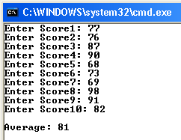
Using a for Loop with an Array
Iterating over the array – reading values from the array:
int total = 0;
int avg;
// Values are summed
for (int index = 0; index < scores.Length; index++) {
total += scores[index];
}
avg = total / scores.Length;
Console.WriteLine();
Console.WriteLine("Average: {0}", avg);

Slide 21
foreach Loop
The foreach statement can be used to iterate through an array (similar to Python's for)
Read-only – so can't change any values in the array, while inside the foreach loop
Syntax:
    foreach (type identifier in arrayName){
    // can use identifier, but can't change it
    }
Example:
    string[] colours = {"red", "green", "blue"};
    foreach (string colour in colours) {
    Console.WriteLine(colour);
    }

Slide 22
Activity
HINT: Copy and paste the algorithm into VS as your design (comments)
Write a program that does the following:
Create an array containing the days of the week
Using a foreach loop, output each day of the week to the screen
Ask the user which day of the week is their favourite – but ask them to enter a number instead of the word (Use TryParse to handle invalid input type)
Using a for loop (to iterate through the list of days) and an if block, print the day of the week that corresponds to that number

Slide 23
Some Finer Points of Using Arrays
Scope of index variable
Array assignment
Array as a parameter
Array as a method return type
Limitations

Slide 24
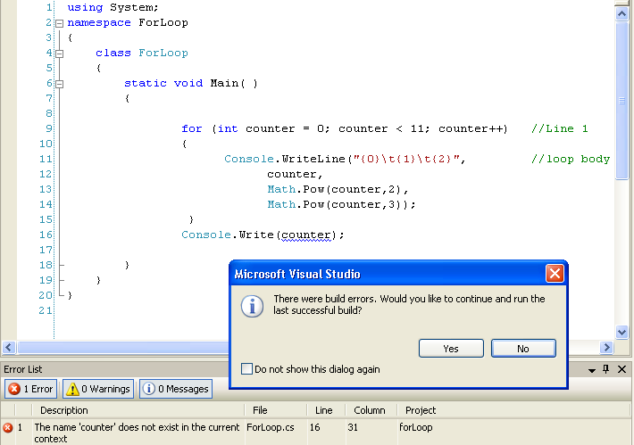
Scope of an Index Variable
When an index variable is declared inside a for loop, it ceases to exist when that loop is finished
counter out of scope

Slide 25
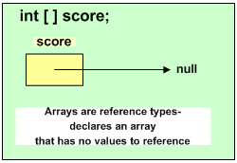
Array Declaration
You can declare an array without giving it an initial size e.g.
    int[] scores;
(Doyle, 2014)

Slide 26
Array Declaration continued
If you declare an array with no size, then it has no memory allocated for its values, so a second step is required.
General form (syntax) of the second step is:
    identifier = new type [whole-number];
Example:
    int[] scores;
    . . .
    int size = 14;
    …
    scores = new int[size];

Slide 27
Array Assignment
Assignment operator (=) does not work with arrays as you might think
For example:
    int[] temperature = new int[] {78, 82, 90, 87, 85};
    int[] t;
    t = temperature;
    // t and temperature refer to the same array!
    t[1] = 44; // what does this do??

Slide 28
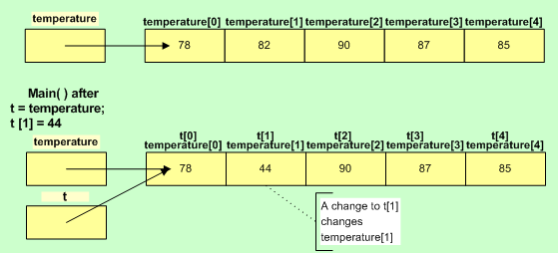
Array Assignment
(Doyle, 2014)

Slide 29
Arrays as Parameters
We can use arrays as arguments to methods.
Example:
  double[] waterDepth = {45, 19, 2, 16.8, 190, 0.8…};
  DisplayArrayContents (waterDepth);
  . . .
  void DisplayArrayContents (double[] anArray){
  . . .
  }

Slide 30
Arrays as Parameters
The call to the method i.e.:
DisplayArrayContents (waterDepth);
  does not include the square brackets
  does not include the array length/size
The general format of the method is:
  returnType methodName (type[] arrayName ...)
  square brackets are required
  does not include the array length

Slide 31
Arrays as Return Types
Methods can return arrays
Example:
    int[] points;
    points = GetScores(); // method call
the method definition:
    static int[] GetScores() {
    int[] scores = new int[10];
    …
    return scores;
    }
Method return type

Slide 32
Array Limitations
Cannot change the length of the array after it is created
This is a problem for programs that may have to deal with a large amount of data and exactly how much data is not known in advance.
  If you make the array too small, then the program will be redundant
  If you make the array too big, then the program will consume more memory than it needs to, possibly causing the user’s computer to run much more slowly

Slide 33
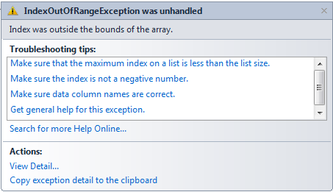
Need to be careful when using arrays
Most common run time error with arrays is
"Index out of range" (out of bounds error)

Slide 34
List<T> Class
Part of System.Collections.Generic
T is an identifier used to define a generic type
    when you create a List object, you specify the actual type
It is like an array:
  Access elements by index (starting from 0)
Unlike an array:
  Can dynamically change size
  Example:
  List<string> students = new List<string>();

Slide 35
List<T> Properties and Methods
Add(…) (method)
appends an element to the end e.g.:
students.Add("Tom");
students.Add("Harry");
Remove(…) (method)
removes the first occurrence of a specific object
RemoveAt(…) (method)
removes the element at the specified index
Count (property)
gets the number of actual elements it contains (2 in this case)
Capacity (property)
gets the current size (potentially more than Count…)
…and many more: https://msdn.microsoft.com/en-us/library/6sh2ey19(v=vs.110).aspx

Slide 36
List <T> Example
List<string> sentences = new List<string>();
sentences.Add("Today is the first day of the rest of your life!");
sentences.Add("Live it to the fullest!");
sentences.Add("Ok.");
sentences.Add("You may not get a second chance.");
// Print out the 2nd element
Console.WriteLine(sentences[1]);
Console.WriteLine("Count of elements: {0}", sentences.Count);
// Remove the element at index 2 ("Ok.")
sentences.RemoveAt(2);
Console.WriteLine("New Count (after removing Ok): {0}",
sentences.Count); // 3
foreach (string sentence in sentences) {
Console.WriteLine(sentence);
}

Slide 37
Two-Dimensional (2-D) Arrays
Some applications have data which is best modelled using two dimensions e.g.:
  the assessment marks for students in a class
  daily rainfall figures for a year for the 8 capital cities in Australia (365 days by 8)
  monitor screen output (m lines by n columns)
  seating in a theatre (x rows of y seats)

Slide 38
Visualise as a table of values (matrix)
columns
0 1 2 3 4 5 6 7 8 9
0
1
2
3
4
rows

Slide 39
2-D Arrays
Two-dimensional and other multidimensional arrays follow the same general guidelines
Declaration format
  type[,] identifier = new type [integer, integer];
  Two integers required for a 2-D array representing: number of rows first, then the number of columns e.g.:
int [,] table = new int [ROWS, COLUMNS]; // using constants
char [,] screen = new char [25, 80];
// row 3, column 4
table[3, 4]
// is different to … row 4, column 3
table[4, 3]

Slide 40
Visualise as a table of values (matrix)
Column indexes
0 1 2 3 4 5 6 7 8 9
0
1
2
3
4
 |  |  |  | 3,4
 |  |  | 4,3
Row
indexes
// row 3, column 4
table[3, 4]
// row 4, column 3
table[4, 3]

Slide 41
2-D Array Declaration
Another example (create a 7 row x 3 column array)
  int[,] calories = new int[7, 3];
Or with initialisation:
int[,] calories = { {900, 750, 1020},
{300, 1000, 2700},
{500, 700, 2100},
{400, 900, 1780},
{600, 1200, 1100},
{575, 1150, 1900},
{600, 1020, 1700} };

Slide 42
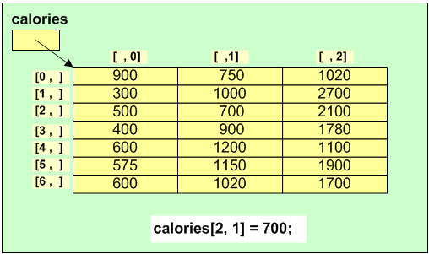
2-D Array
calories references address of [0,0]

Slide 43
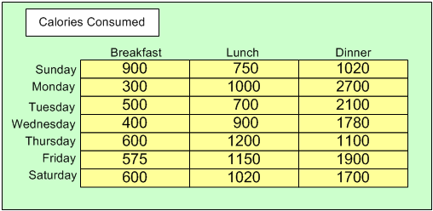
2-D Array Conceptualisation
columns
R
O
W
S
(Doyle, 2014)

Slide 44
2-D Array Properties & Methods
Length (property)
gets total number of elements in all dimensions e.g.:
    Console.WriteLine(calories.Length); // displays 21
GetLength(…)(method)
gets the number of rows or number of columns e.g.:
  GetLength(0) // returns number of rows
  GetLength(1) // returns number of columns
    // Display number of columns (3 in this case)
Console.WriteLine(calories.GetLength(1));
// Display number of rows (7 in this case)
Console.WriteLine(calories.GetLength(0))

Slide 45
2-D Array Properties & Methods
Rank (property)
gets the number of dimensions of the array e.g.:
// Display number of dimensions (2 in this case)
Console.WriteLine(calories.Rank);

Slide 46
Working with 2-D arrays
Usually requires two (nested) for loops:
    // for each row in the 2-D array
    for (int row = 0; row < calories.GetLength(0); row++) {
      // for each column in the 2-D array
      for (int column = 0; column < calories.GetLength(1); column++) {
      Console.WriteLine("Row {0} Column {1} has the value {2}", row,
      column, calories[row, column]);
    } // end inner for
    } // end outer for
Output is: Row 0 Column 0 has the value 900
        Row 0 Column 1 has the value 750
        Row 0 Column 2 has the value 1020
        Row 1 Column 0 has the value 300
        …
        Row 6 Column 2 has the value 1700

Slide 47
Working with 2-D arrays
Sometimes you need extra code between the two for loops e.g. to display all of the row on a line:
// for each row in the 2-D array
    for (int row = 0; row < calories.GetLength(0); row++) {
      Console.Write("Row {0}: ", row);
      // for each column in the 2-D array
      for (int column = 0; column < calories.GetLength(1); column++) {
      Console.Write("\t{0}", calories[row, column]);
    }
      Console.WriteLine("");
  }
Output is: Row 0: 900 750 1020
      Row 1: 300 1000 2700
      ...
      Row 6: 600 1020 1700

Slide 48
Working with 2-D arrays
Process a single dimension e.g.: number of calories consumed on a particular day of the week (row):
int dailyTotal = 0;
int day = 5; // Friday, day 6, row index 5
for (int column = 0; column < calories.GetLength(1); column++) {
    dailyTotal = dailyTotal + calories[day, column];
  }
    Console.WriteLine ("On this day your calorie intake was " + dailyTotal);
Output is:
On this day your calorie intake was 3625
does not change

Slide 49
Working with 2-D arrays
Process a single dimension e.g.: number of calories consumed at lunch during the week (column):
int mealTotal = 0;
int meal = 1; // Lunch, meal 2, column index 1
for (int row = 0; row < calories.GetLength(0); row++) {
mealTotal = mealTotal + calories[row, meal];
}
Console.WriteLine ("This week at lunch your calorie intake was " +
mealTotal);
Output is:
On this day your calorie intake was 6720
does not change

Slide 50
Higher-Dimensional Arrays
Limited only by your imagination as far as the number of dimensions is concerned
Format for creating three-dimensional array
    type[, ,] identifier =
    new type [integer, integer, integer];
Example (rectangular)
    int[, ,] calories = new int [4 ,7 ,3];
    (i.e. 4 weeks; 7 days; 3 meals)

Slide 51
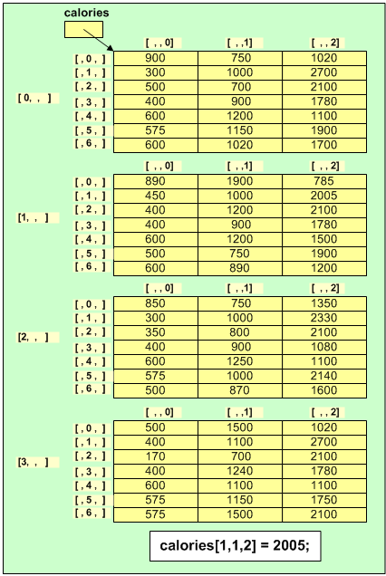
Higher-Dimensional Arrays
(Doyle, 2014)

Slide 52
Array of Arrays (different to 2D Arrays)
Each element (of the array of arrays) is an array!
type[][] identifier = new type [integer][];
Example of declaration - array of (7) arrays:
int[][] calories = new int[7][];

Slide 53
Array of Arrays
Initialisation e.g.:
calories[0] = new int[] { 900, 750, 1020};
calories[1] = new int[] { 300, 1000, 2700};
calories[2] = new int[] { 500, 700, 2100};
calories[3] = new int[] { 400, 900, 1780 };
calories[4] = new int[] { 600, 1200, 1100 };
calories[5] = new int[] { 575, 1150, 1900 };
calories[6] = new int[] { 600, 1020, 1700};
Allows you treat each row as a 1-D array which can then be passed as a parameter e.g.: to a method which sums the values in an int array

Slide 54
Array of Arrays
static int SumArray(int[] myArray) {
int total = 0;
for (int i = 0; i < myArray.Length; i++) {
total = total + myArray[i];
} //end for
return total;
} //end SumArray
…
int sum = SumArray(calories[4]);
Console.WriteLine("Thursday calories total " + sum);

Slide 55
Array of Arrays
Possible for each row to be a different length ("jaggered array"):
Example jaggered array:
// a row for each month – different number of days
int[][] rainfall = new int[12][];
rainfall[0] = new int[31];
rainfall[1] = new int[28];
rainfall[2] = new int[31];
rainfall[3] = new int[30];
…
rainfall[11] = new int[31];
Allows you treat each row as a 1-D array.
See: https://msdn.microsoft.com/en-us/library/2s05feca.aspx

Slide 56
Array of Arrays
Initialisation of jaggered array e.g.:
// allocate memory for an array of arrays with 12 rows
int[][] rainfall = new int[12][];
// then initialise each row
rainfall[0] = new int[] {21, 0, 5, … <31stValue>};
rainfall[1] = new int[] {61, 11, 18, … <28thValue>};
rainfall[2] = new int[] {87, 91, 78, … <31stValue>};
rainfall[3] = new int[] {77, 51, 48, … <30thValue>};
…
rainfall[11] = new int[] {1, 12, 0, … <31stValue>};

Slide 57
Array of Arrays
Alternative initialisation of jaggered array e.g.:
// allocate memory and initialise at once
int[][] jaggered = new int[][] {
new int[] {900},
new int[] {300, 1000, 2700},
new int[] {500, 2100},
new int[] {400, 1780, 1, 4, 5},
new int[] {600, 1200, 1100},
new int[] {575, 1150, 1900, 1, 2, 3, 4, 5, 6},
new int[] {600, 1020, 1700}
};

Slide 58
Questions??

